Slide 1
MMI 508/608: Current Trends in Music Engineering III
Audio Programming for iOS Mobile Applications (“Apps”)

Slide 2
Syllabus Highlights
Text: iOS Programming: The Big Nerd Ranch Guide (4th Ed.)
5-ish Tests (Project-based), worth 16% of your grade each
1 Final (Project-based), worth 20% of your grade
Office hours: before class, or by appointment

Slide 3
Source Control
Track changes to the code over time
Work with more than 1 person
Review each other’s code
Merge multiple changes to the same code
Blame people who break builds
Integrated into XCode
Tag releases
Branch new features (and keep them separate) without breaking the codebase

Slide 4
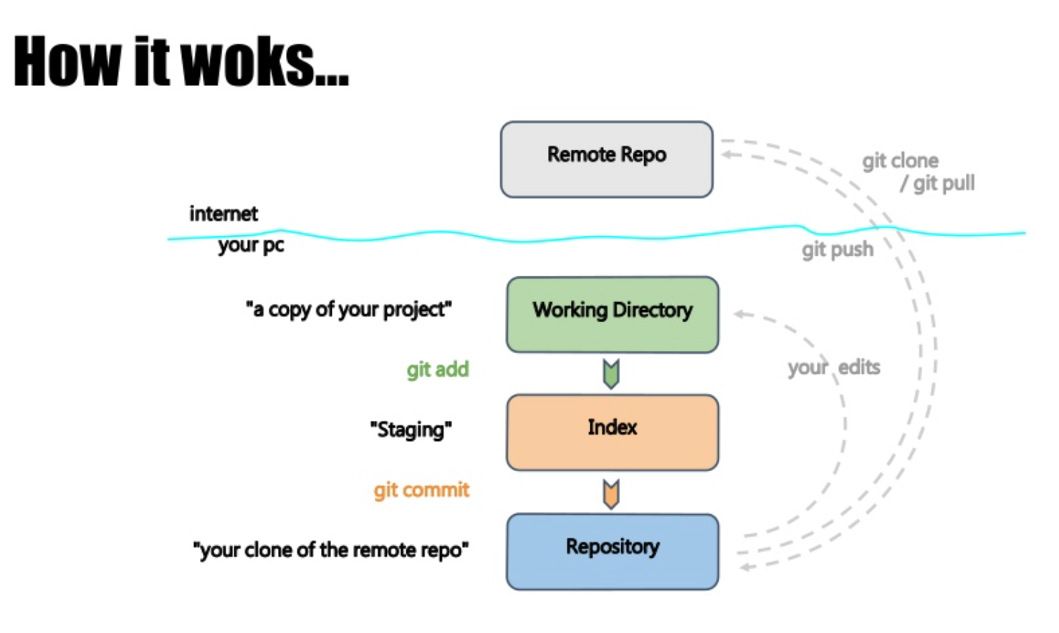
Git

Slide 5
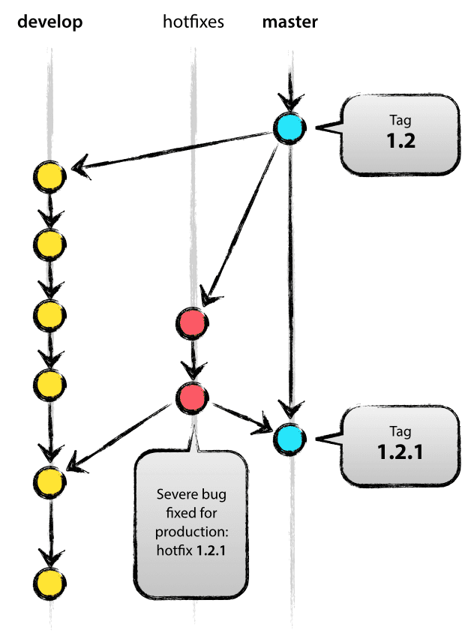
Git Branch (aka “Fork”)
(aka “Trunk” or “origin”)
pull
(aka “update”)
commits
push
push

Slide 6
Git
Create account at GitLab and send your username to bennett@miami.edu
Use Terminal and navigate to your home folder
$cd ~
Clone the MMI508_608 project to your computer
$git clone https://gitlab.com/dr_bennett/MMI508_608.git
Cloning into 'MMI508_608’…
Username for 'https://gitlab.com': your_name
Password for 'https://your_name@gitlab.com': *

Slide 7
Git
All you need to do is clone and pull fixes (if I have any)…
You may also...
add and commit to keep track of your changes locally
push to send me fixes to review

Slide 8
Swift
“soft” or “loose” types
A variable takes its type upon assignment (float, int, string, nil, etc.)
“optional” types
A variable can take a type OR can be nil
Can operate on nil-value variables without crashing or extensive nil-checking
“String interpolation” allows for simpler string commands (e.g., string concatenation)

Slide 9
Swift
Advanced Enumeration
Enum members can have multiple properties
Easily extend Protocols (interfaces in C++)
Operating overloading; new operators
No header files
Functions are “first class”
Variables can hold functions; functions can return other functions; functions can accept functions as an argument

Slide 10
Swift
Variables can be “tuples”
Holds more than one value; useful for returning multiple data (e.g., complex numbers)
Still a major work in progress…
Substantial changes every release
Extra ‘layer’ of programming (in addition to Objective-C and C++ used already for audio)
Many existing concepts with new Apple names

